Slide 1
Panama

Slide 2
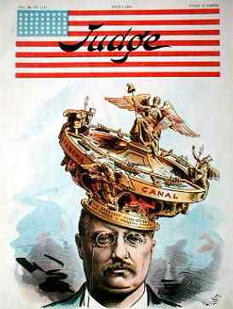
Panama: The King’s Crown
Spooner Act of 1902 allowed the US to buy the rights of the Panama Canal Zone from the French for $40 Million, but required a treaty be made with Columbia
Treaty could not be made and Roosevelt said he would back a Panamanian Revolution
Philippe Bunau-Varilla, agent provocateur helped start rebellion.
1903 → Hay-Bunau- Varilla Treaty- Gave US a permanent grant of a 10 mile wide strip of land for a Canal over which US would have complete control and Panama would receive $10 million dollars.
“I took the Canal Zone and let Congress debate” –T.R.

Slide 3
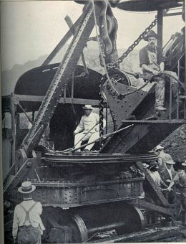
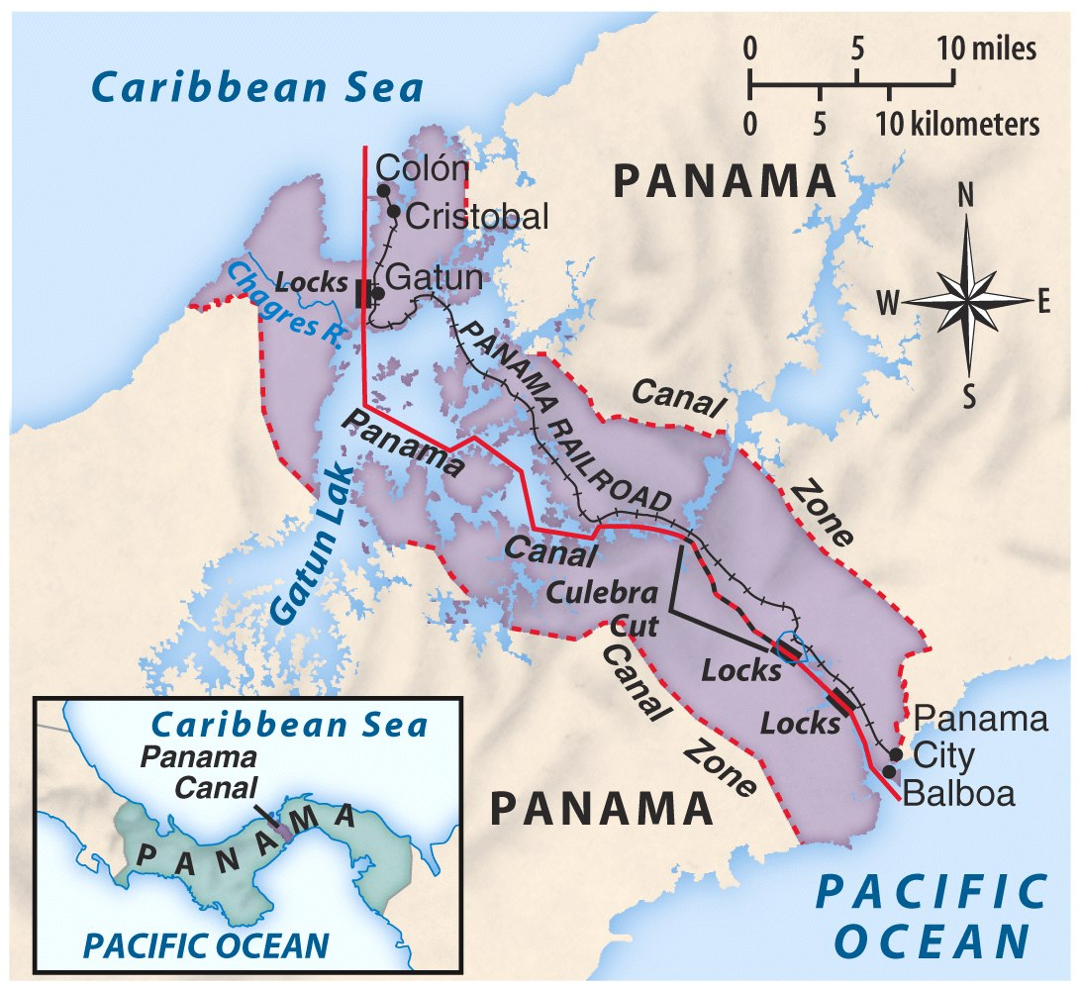
Panama Canal
TR in Panama (Construction begins in 1904)
https://www.youtube.com/watch?v=q2T7CL9wqyM

Slide 4
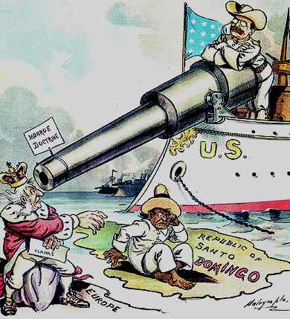
The Roosevelt Corollary to the Monroe Doctrine: 1905
Chronic wrongdoing… may in America, as elsewhere, ultimately require intervention by some civilized nation, and in the Western Hemisphere the adherence of the United States to the Monroe Doctrine may force the United States, however reluctantly, in flagrant cases of such wrongdoing or impotence, to the exercise of an international police power .
Would justify intervention in numerous Latin American countries in the future
Haiti, Dominican Republic, Venezuela, Mexico, Nicaragua

Slide 5
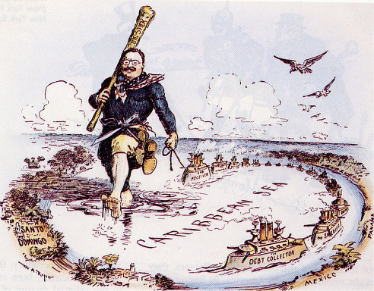
Speak Softly, But Carry a Big Stick!

Slide 6
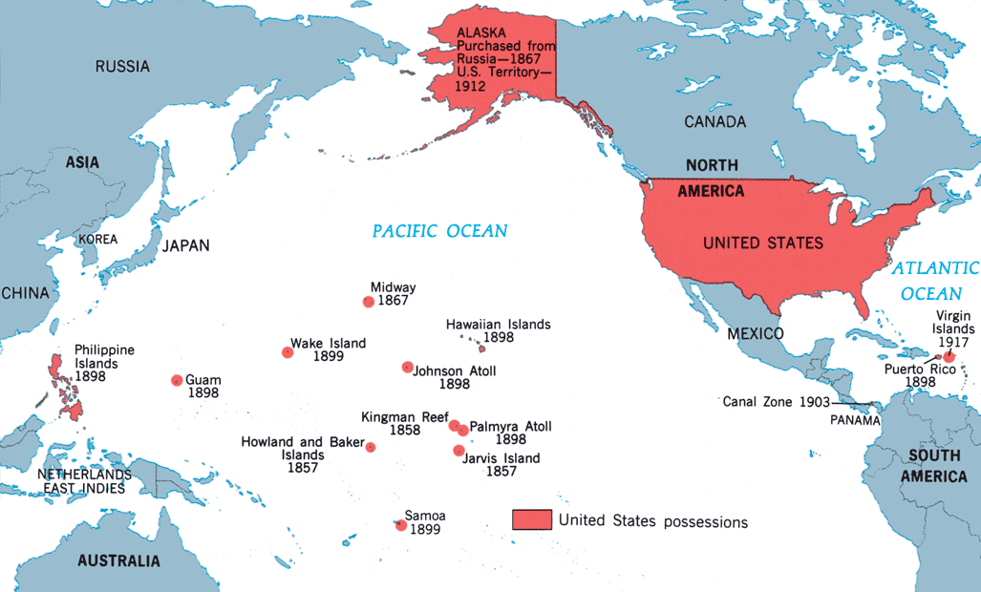
America as a Pacific Power

Slide 7
America's
New
Role

Slide 8
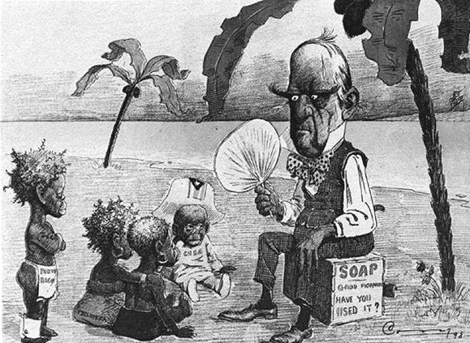
The Cares of a Growing Family

Slide 9
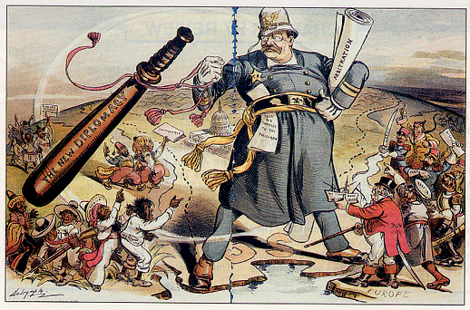
Constable of the World

Slide 10
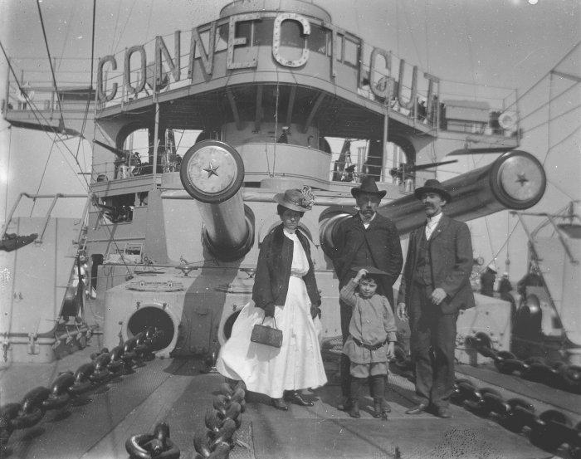
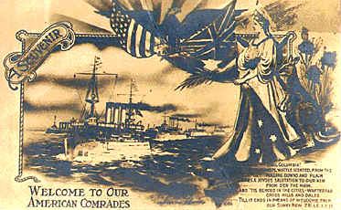
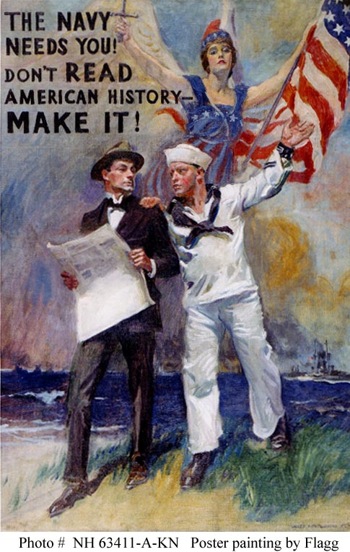
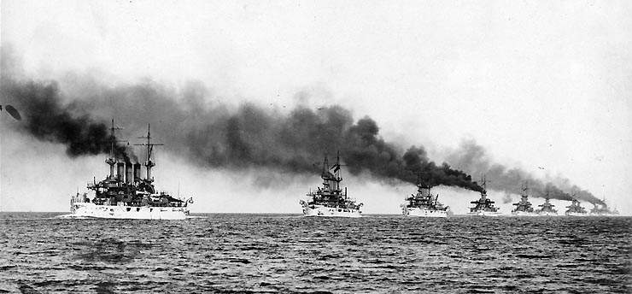
The Great White Fleet: 1907

Slide 11
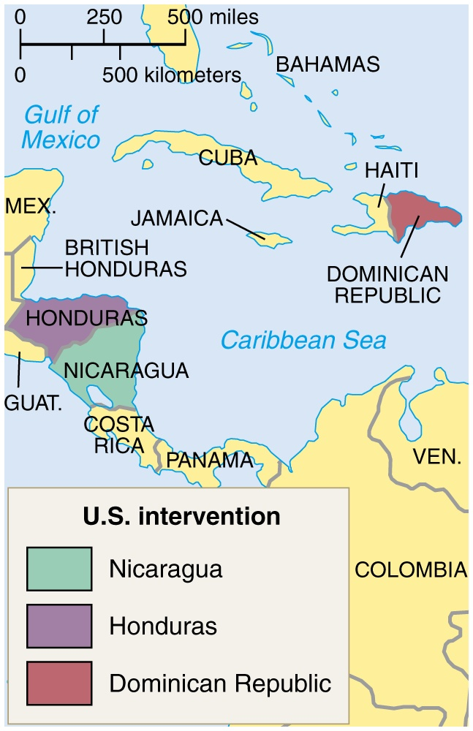
Taft’s “Dollar Diplomacy”
Improve financial opportunities for American businesses.
Use private capital to further U. S. interests overseas.
Therefore, the U.S. should create stability and order abroad that would best promote America’s commercial interests.
Though “Dollar Diplomacy” had some positive effects it also lead to mistrust in Latin America and investment loss in Asia.

Slide 12
Mexico

Slide 13
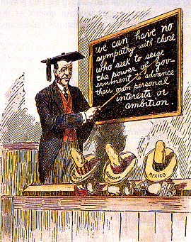
Wilson’s “Moral Diplomacy”
The U. S. should be the conscience of the world.
Spread democracy.
Promote peace.
Condemn colonialism.

Slide 14
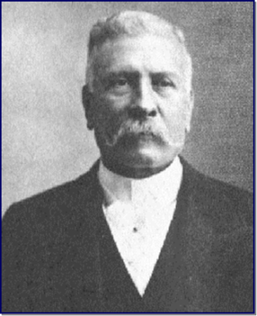
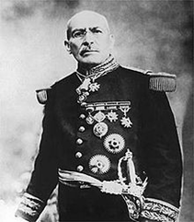
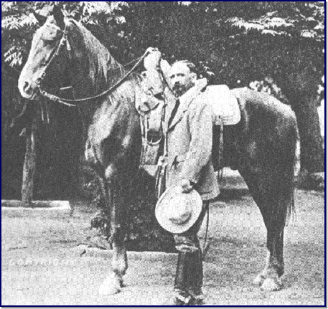
The Mexican Revolution: 1910s
In 1911, a revolution forced Mexico’s longtime dictator, Porfirio Diaz, to resign.
New president , Francisco Madero, promised democratic reforms but could not unite his deeply divided and impoverished nation.
In 1913 Victoriano Huerta overthrew Madero and had him killed.
US was unsure how to respond to Huerta’s actions. US had 1 billion dollars invested into Mexican oil, mines, land and railways.
Huerta promised to protected foreign investments, most European countries recognized Huerta as the legitimate leader of Mexico
Porfirio Diaz
Victoriano
Huenta
Francisco I Madero

Slide 15
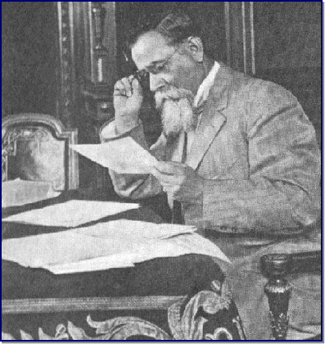
U.S. and Mexico
US investors urged President Wilson to do the same as the Europeans, but he refused due to his “Moral Diplomacy” stance
To Wilson, Huerta was a “butcher” ruling without the consent of the people.
This stance lead the US into a bloody confrontation with Mexico
Another Mexican leader, Venustiano Carranza, was making military progress against Huerta and Wilson supported him by blocking all munitions from reaching Huerta’s forces.
In April 1914, American sailors were arrested in Tampico, Mexico giving Wilson the excuse to act militarily against Huerta.
Wilson sent the American navy to occupy the port city of Veracruz, a Mexican port on the Gulf of Mexico.
Over 100 Mexicans died in the resistance of the occupation of Veracruz leading Mexican political groups to unite against the United States.
Huerta resigned to Carranza in July 1914 due to the lack of munitions for his forces.
Wilson withdrew the US Navy
Venustiano Carranza

Slide 16
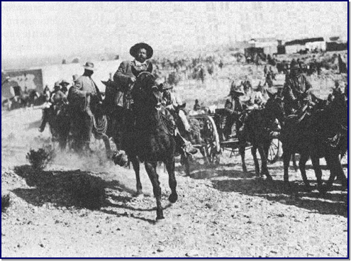
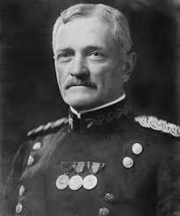
“Pancho” Villa
Pancho Villa
Wilson was drawn into Mexican affairs again when rebel leader “Pancho” Villa gathered a force to oppose the leadership of Carranza.
Villa opposed Wilson’s support of Carranza and began terrorizing Americans living in Mexico and raiding US/Mexico border towns
In March of 1916 Villa’s men crossed the US border into Columbus, New Mexico burning the town and killing 15 people.
Wilson sent General John J. “Black Jack” Pershing with 5000 troops into Mexico to pursue Villa
Carranza demanded that the US troops leave Mexico
Bloody clashes between Pershing’s forces and regular Mexican troops took place
Pershing failed to find Villa and in 1917 Wilson withdrew troops from Mexico.
John J. Pershing

Slide 17
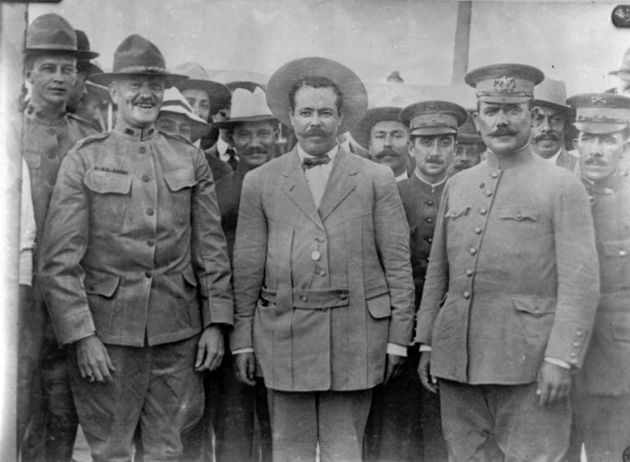
Searching for Banditos
General John J. Pershing with Pancho Villa in 1914.

Slide 18
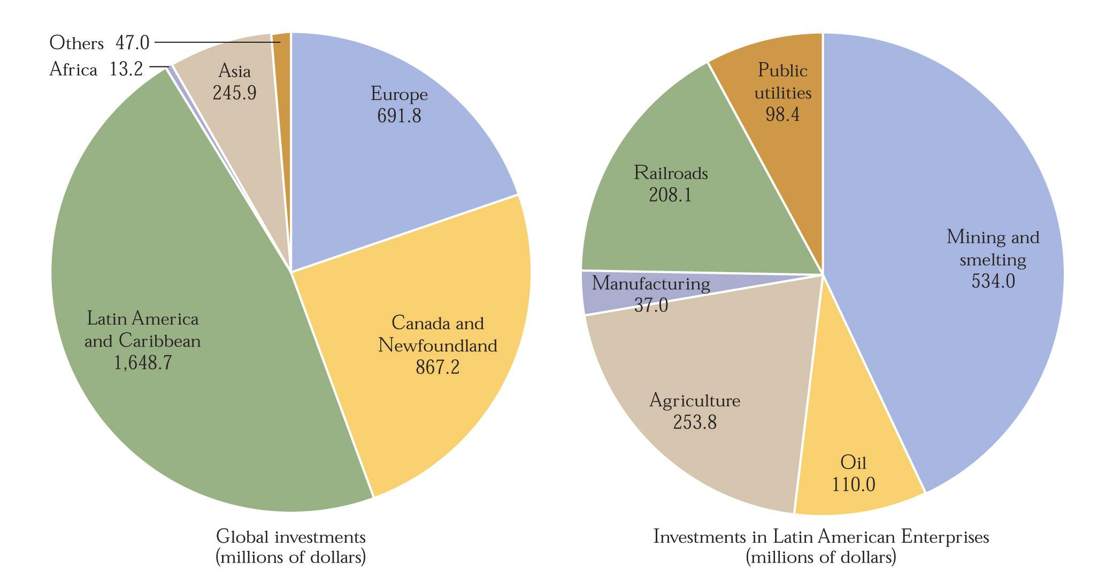
U. S. Global Investments & Investments in Latin America, 1914

Slide 19
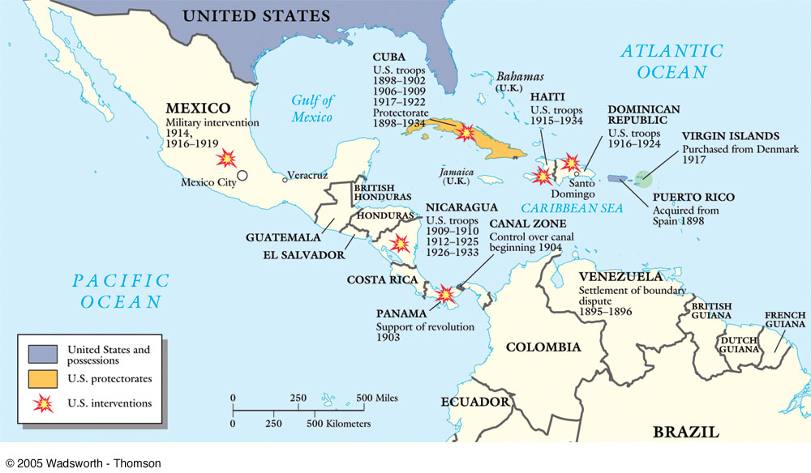
U. S. Interventions in Latin America: 1898-1920s

Slide 20
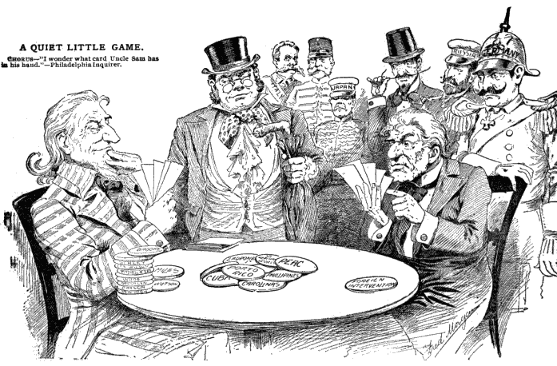
Uncle Sam: One of the “Boys?”

