Slide 1
Essential Question:
Why did America
join the imperialist
club at the end
of the 19c?

Slide 2
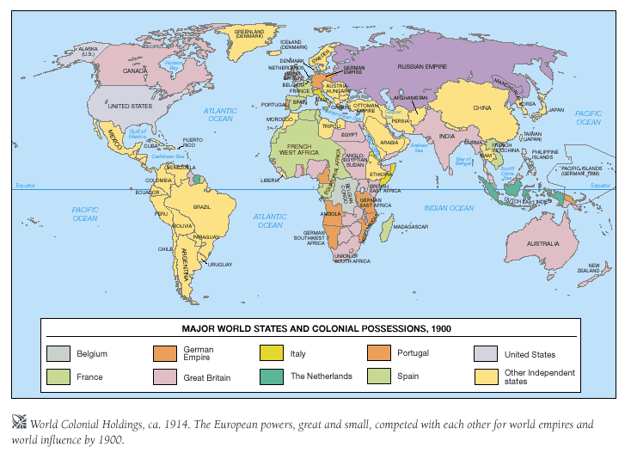

Slide 3
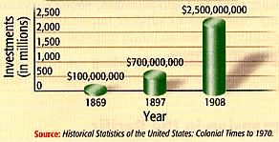
1. Commercial/Business Interests
U. S. Foreign Investments: 1869-1908

Slide 4
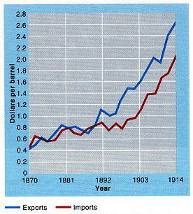
1. Commercial/Business Interests
American Foreign Trade: 1870-1914

Slide 5
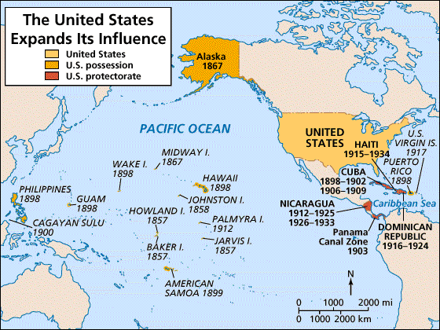
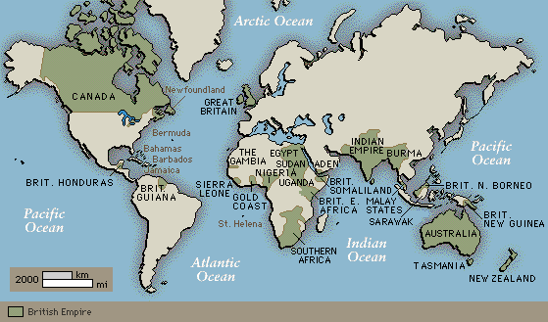
2. Military/Strategic Interests- Join the European Big Boys
Alfred T. Mahan → The Influence of Sea Power on History: 1660-1783
Naval Strength of USA:
1870’s- small weak navy
1898- 5th largest Navy
1900- 3rd largest Navy
Captain and later Admiral in the Navy.
Simple premise: Countries with sea power were the greatest nations of history.
America should acquire defensive bases in the Caribbean and the Pacific and take possession of Hawaii and other Pacific islands.

Slide 6
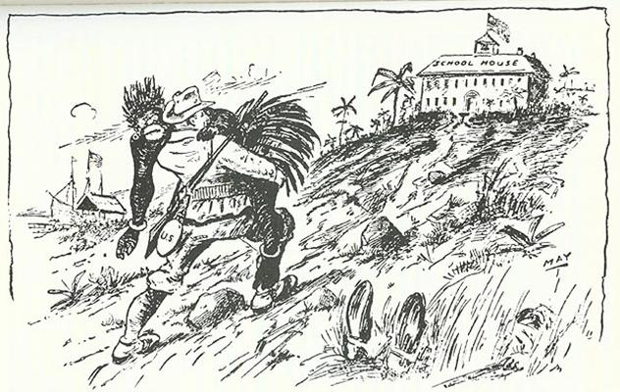
3.Social Darwinist Thinking
The Hierarchy of Race
Nations or “races, like biological species, struggled constantly for existence and that only the fittest could survive. Strong nations dominate weak ones was, therefore, in accordance with the laws of nature
The White Man’s Burden

Slide 7
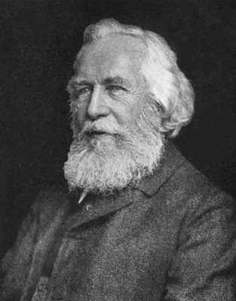
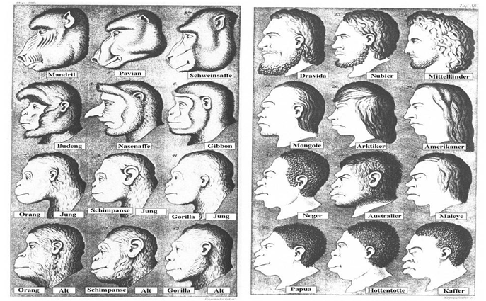
Race Science
In Germany, Ernst Haeckel, a biologist, popularized “race science” by combining it with romantic ideas about the German national identity. In a book called Riddle of the Universe, he divided humankind into races and ranked each. People of European descent were called Aryans.* Not surprisingly, Aryans were at the top of his list and Jews and Africans at the bottom.
Haeckel was also taken with the idea of eugenics—breeding “society’s best with best”—as a way of keeping the “German race” pure. Scientists who tried to show that there was no “pure” race were ignored.
Studies refuting Haeckel were discarded and later banned in Germany.

Slide 8
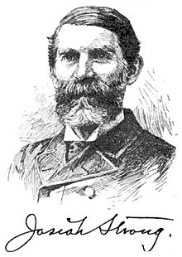
Josiah Strong
In his 1885 book Our Country, Strong argued that Anglo Saxons are a superior race who must "Christianize and civilize" the "savage" races, which he argued would be good for the American economy and the "lesser races".
Leader of the Social Gospel Movement

Slide 9
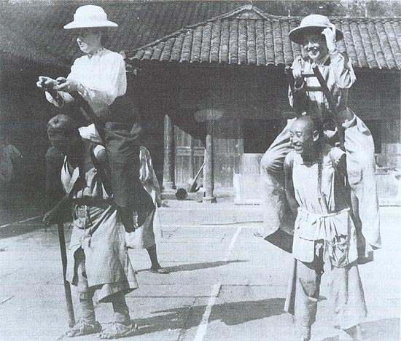
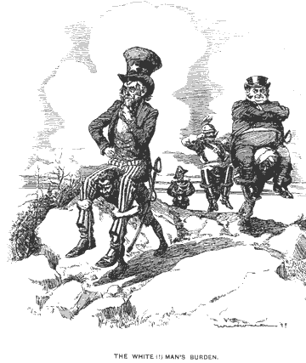
4. Religious/Missionary Interests
American Missionaries in China, 1905

Slide 10
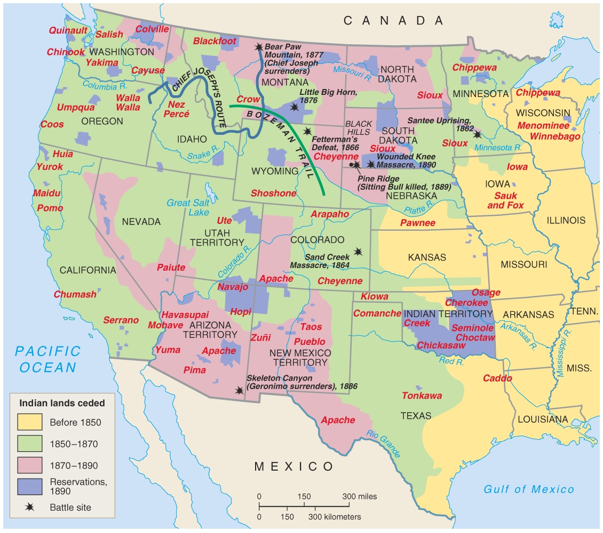
5. Closing the American Frontier
Fear that the closing of the Frontier would lead to dwindling natural resources

Slide 11
Hawaii:
"Crossroads
of the
Pacific"

Slide 12
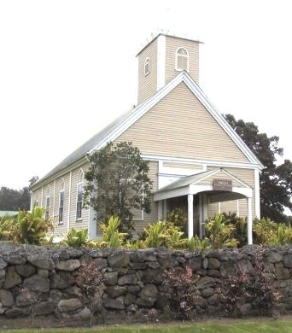
US contact with Hawaii
Settled around 1500BC by Polynesians
Agricultural and fishing society
First contact with Americans was in 1790’s
King Kamehameha I welcomed American traders, developed thriving trade
Missionaries soon followed the traders to Hawaii
Imiola Church – first built in the late 1820s

Slide 13
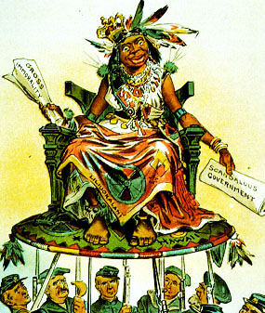
US Contact with Hawaiians
Arrival of these merchants, missionaries, and planters was devastating to native Hawaiian society.
Americans brought disease (1/2 of native population died by mid 19th century)
Missionary work to replace native religion with Christianity
Introduction of liquor, firearms, and a commercial economy eroded the traditional character of Hawaiian society
By late 1840’s land in Hawaii was being bought by large American planters

Slide 14
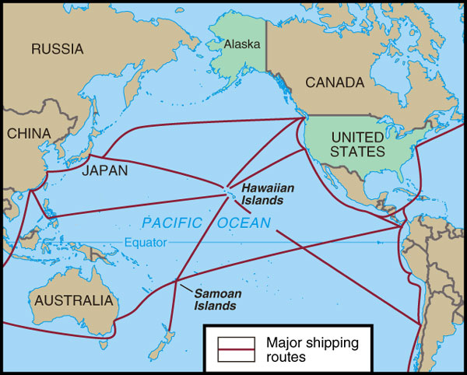
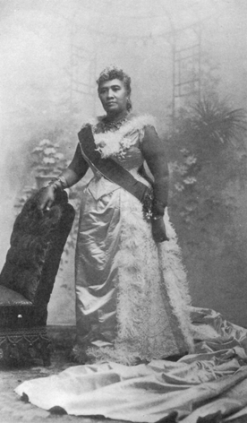
Hawaiian Queen Liliuokalani
Hawaii for the Hawaiians!
1887 treaty to open naval base at Pearl Harbor
Hawaiian economy based mostly on American-dominated sugar plantation exports
Native Hawaiians did not except the changes to their native society
Elected a nativist leader to throne: Queen Liliuokalani
Liliuokalani wanted to restore Hawaii back to native Hawaiians

Slide 15
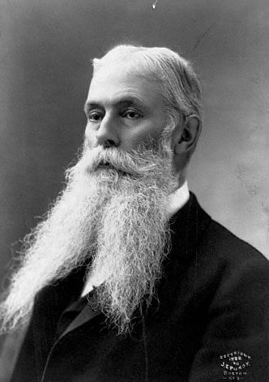
Sugar Cane Economy Crashes
1875 – Reciprocity Treaty: Exemption from Tariff
1890 – McKinley Tariff: Ended Exemption for Hawaii and Devastated the Hawaiian Economy
1893 – American businessmen backed an uprising against Queen Liliuokalani.
Sanford Ballard Dole proclaims the Republic of Hawaii in 1894.

Slide 16
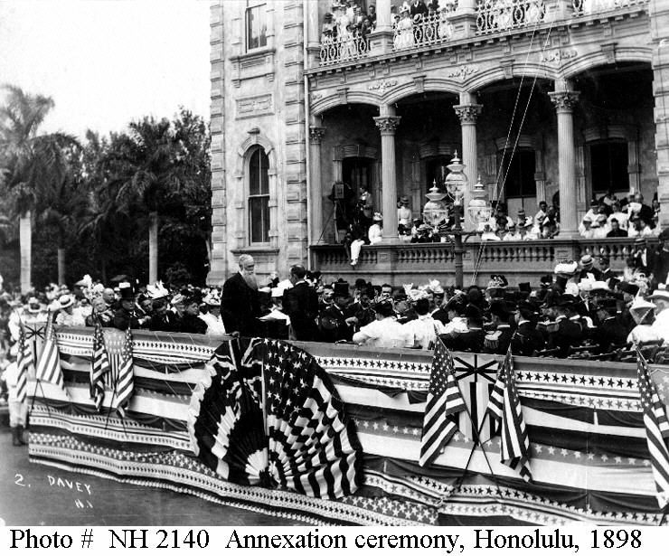
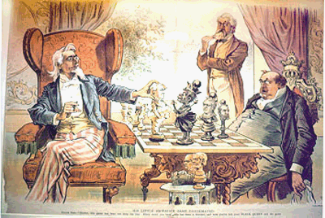
To The Victor Belongs the Spoils
Hawaiian Annexation Ceremony, 1898

Slide 17
Headline
“Search For Missing Bride Continues”
“Cold Feet Suspected in Case of Missing Bride”
“Bride Missing! Recent Fight With Groom’s Family”
How do these headlines differ?
Consider the wording and how a reader might respond to each article.

