Slide 1
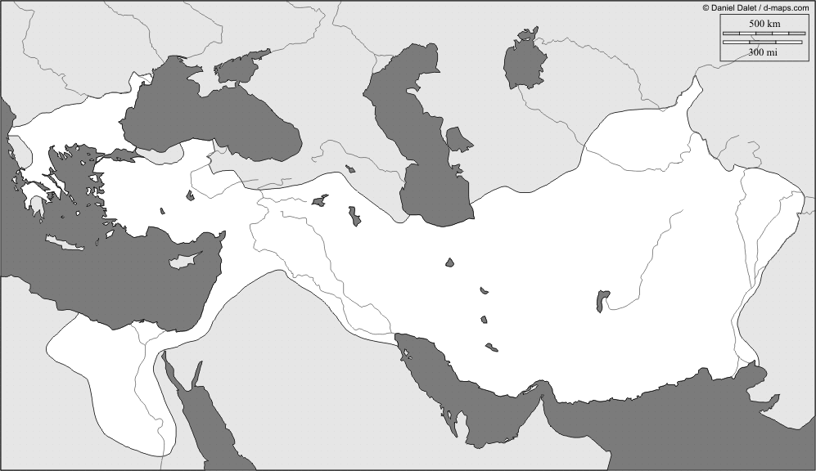
Alexander the Great/ Hellenistic Empire: 336-323BCE

Slide 2
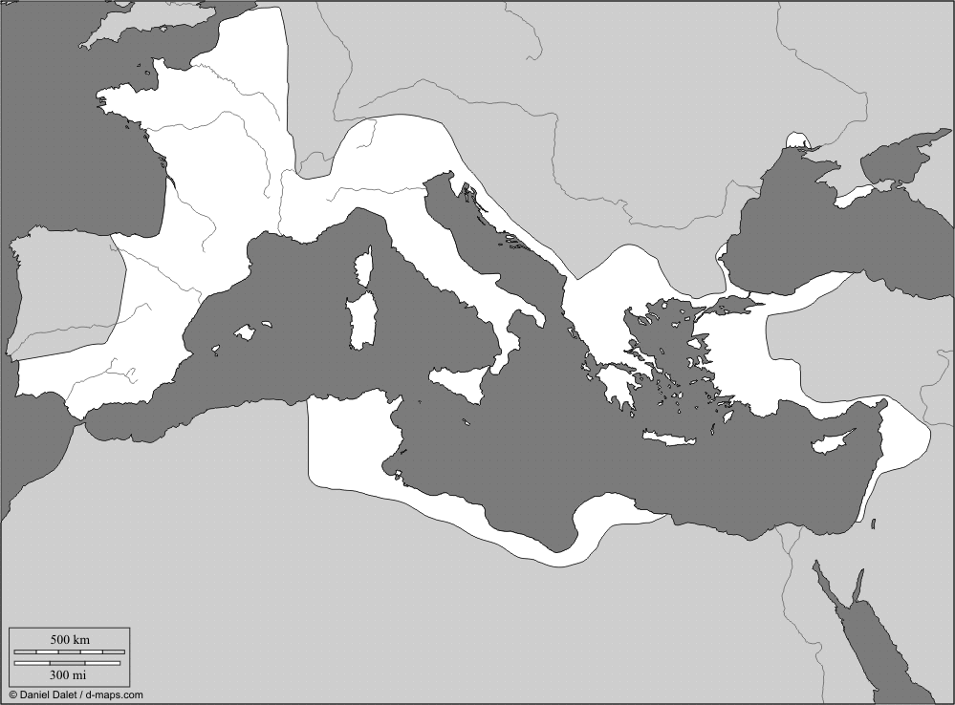
Roman Republic: 31BCE

Slide 3
Alexander the Great Empire
Use Pg. 10 and 11
Bodies of Water: Black Sea, Mediterranean Sea, Red Sea, Caspian Sea, Persian Gulf, Arabian Sea, Tigris River, Euphrates River, Nile River
Cities: Persepolis, Tyre, Alexandria, Alexandria Ariorum, Alexandria Arachoton, Alexandria Opiana, Babylon, Issus, Gordium, Jerusalem, Pergamum, Pella, Thebes, Athens, Sparta
Empire Breakup (color and label): Seleucid Kingdom, Ptolemaic Kingdom, Antigonid Kingdom
With a dotted line trace out the rout of Alexander the Great
Roman Republic
Use Pg. 14 and 15
Bodies of Water: Mediterranean Sea, Atlantic Ocean, Adriatic Sea, Tyrrhenian Sea, Aegean Sea
Territories (Label in ALL CAPS): Gaul, Hither Spain, Farther Spain, Italy, Illyricum, Macedonia, Numidia, Sicily, Asia, Syria
Cities: Rome, Syracuse, Carthage
Color the extent of Roman rule in the year 31BCE
Alexander the Great Empire
Use Pg. 10 and 11
Bodies of Water: Black Sea, Mediterranean Sea, Red Sea, Caspian Sea, Persian Gulf, Arabian Sea, Tigris River, Euphrates River, Nile River
Cities: Persepolis, Tyre, Alexandria, Alexandria Ariorum, Alexandria Arachoton, Alexandria Opiana, Babylon, Issus, Gordium, Jerusalem, Pergamum, Pella, Thebes, Athens, Sparta
Empire Breakup (color and label): Seleucid Kingdom, Ptolemaic Kingdom, Antigonid Kingdom
With a dotted line trace out the rout of Alexander the Great
Roman Republic
Use Pg. 14 and 15
Bodies of Water: Mediterranean Sea, Atlantic Ocean, Adriatic Sea, Tyrrhenian Sea, Aegean Sea
Territories (Label in ALL CAPS): Gaul, Hither Spain, Farther Spain, Italy, Illyricum, Macedonia, Numidia, Sicily, Asia, Syria
Cities: Rome, Syracuse, Carthage
Color the extent of Roman rule in the year 31BCE

